Slide 1

Email Classification & Data Extraction
AI_Novice
Bharath
Soma

Slide 2
Problem Statement
Commercial Bank Lending service teams receive a significant volume of servicing requests through emails. These emails contain diverse requests, often with attachments and will be ingested to the loan servicing platform and create service requests which will go through the workflow processing. Incoming service requests via email require a manual triage where a “Gatekeeper” who:
Reads and interprets the emails content and attachments
Identify the intent of the email and classify the Request Type and Sub Request Type
Extract key attributes for populating in service requests
Assigns the request to the appropriate team or individual based on roles and skills

Slide 3

High level Design - POC
Email content Extraction
Identify Intent
Classify Email
Print the output
Step 1 : Trigger email Classification solution
User triggers after having the .eml file placed in the source{location
Step 2 : Data Extraction
Internal code is invoked to extract email indent and its attachments and its content
Step 3: Intent identification
Identify the indent from the email content
Step 4 : Gemini AI services
Internally the AI classification service is utilized to classify the email into request and sub request
Step 5 : API Response
User receives API response in the below format
[{'category': 'invoice', 'confidence': 0.95, 'subcategory': 'bill'}]

Slide 4
Solution Description
Our solution is built using Google Gemini LLM model, and also PaddleOCR is used to extract the text from mail attachments i.e., PDF documents. We have used in-built mechanism to identify the main intent of the mail and classify them to spam or genuine use case. Solution is tested with multiple type of mail documents to deliver high accuracy, and it is designed for highly scalability and robustness.
** Performance is based on the training data provided in the hackathon.
** Solution is tested only with 10+ requests and sub requests, due to the limited time of the event.

Slide 5
Benefits
High Accuracy is achieved using Google LLM
Processing speed is much faster comparing to the other models(Hugging face) that we have tried
Easy to train large datasets
Prompt engineering is used to train & classify
High Productivity can be achieved due to the use of prompt engineering in LLM model
Paddle OCR used is an open source with good accuracy

Slide 6
Challenges
Gemini LLM Model is a paid model based on the consumption
Processing time of the PaddleOCR is slightly more than the paid OCR solutions available on the market

Slide 7
Enhancements
This solution can be enhanced to connect to mailbox to read/trigger the solution
This can be enhanced to identify duplicate emails
AWS/Azure/Google OCRs can be used in place of PaddleOCR for better accuracy & performance
Request creation can also be automated
Mail can also be routed to a specific folder based on the classification results

Slide 8
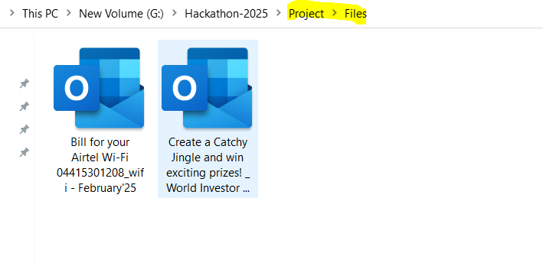
Solution screen shots
Input:
1 or more .eml file placed in folder. Can be a real case scenarios or spam mails.

Slide 9
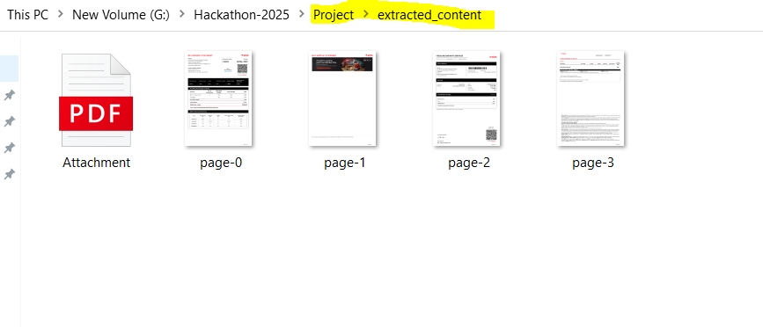
Solution screen shots
Attachment downloaded and extraction using OCR :

Slide 10
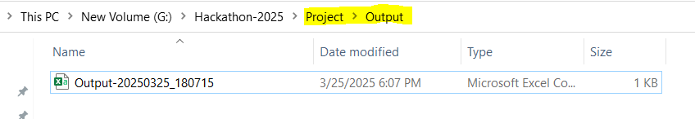
Solution screen shots
Output report with timestamp:
Output report detailing multiple emails and their respective category, subcategory, intent and confidence.

